Slide 1
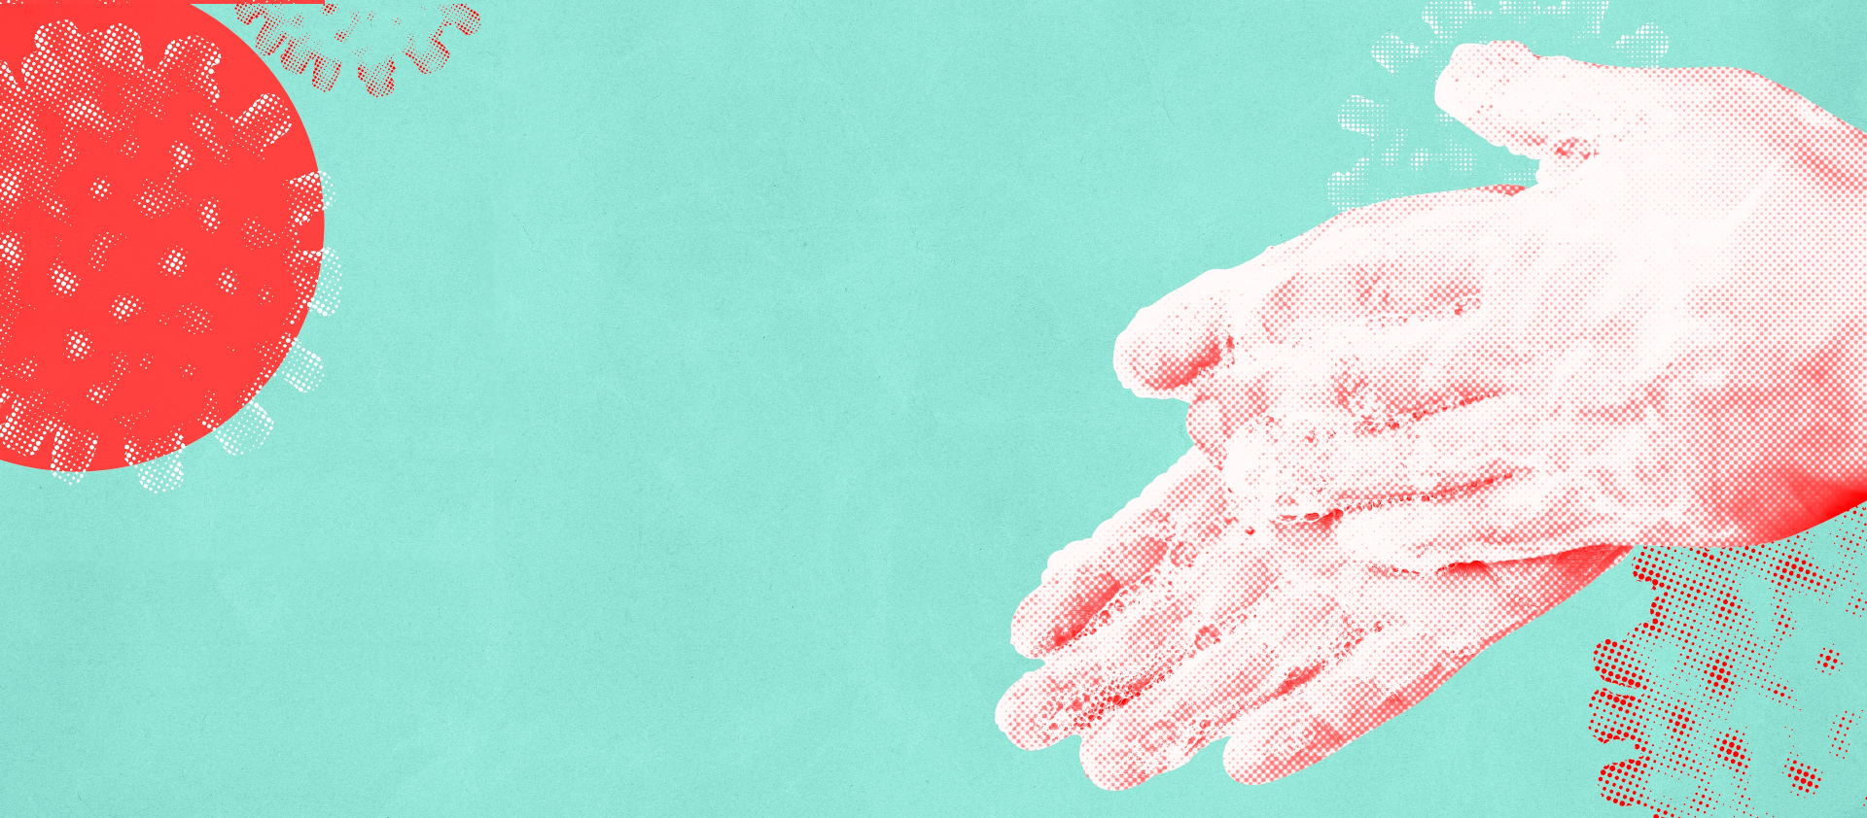
lancashire.gov.uk
KS3 Antimicrobial Resistance
Presented by
Sonya Magrath (Senior Infection Prevention and Control Nurse)
Kassim Sonvadi (Infection Prevention Practitioner)

Slide 2
KS3 Antimicrobial Resistance
This year's focus from World Health Organisation is:
Notes:
(WHO) World AMR awareness week 18th – 24th November 2023. Antimicrobial resistance (AMR) threatens the effective prevention and treatment of an ever-increasing range of infections caused by bacteria, parasites, viruses and fungi.

Slide 3
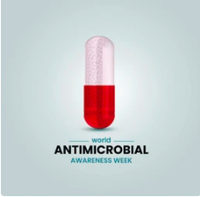
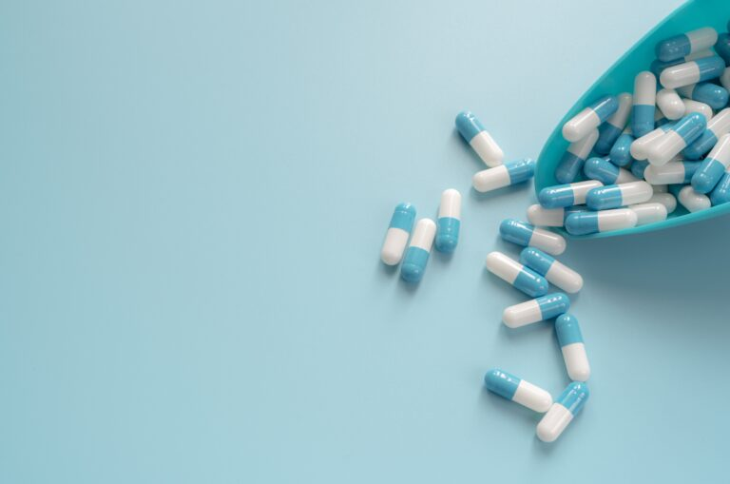
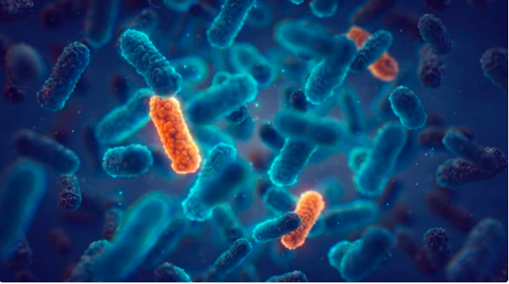
Learning objectives
What are antibiotics?
How does antibiotic resistance occur?
Why does it matter?
What are we doing to confront AMR?
How can we prevent antibiotic resistance getting worse?
Notes:
prevent antibiotic resistance getting worse by:
a. only using antibiotics when prescribed by a health care professional (HCP)
b. finishing your course of antibiotics as recommended by your HCP
c. not using left over antibiotics (if for any reason you don’t finish your course of antibiotics, any left over should be given to your local pharmacy to dispose of)
d. not using antibiotics for most ear aches, sore throats or any colds or flu which are usually caused by viruses.
To confront AMR, the government have created a national action plan, ‘Confronting antimicrobial resistance 2024 to 2029’, which builds on the achievements and lessons of the previous and has 9 strategic outcomes organised under 4 themes.

Slide 4
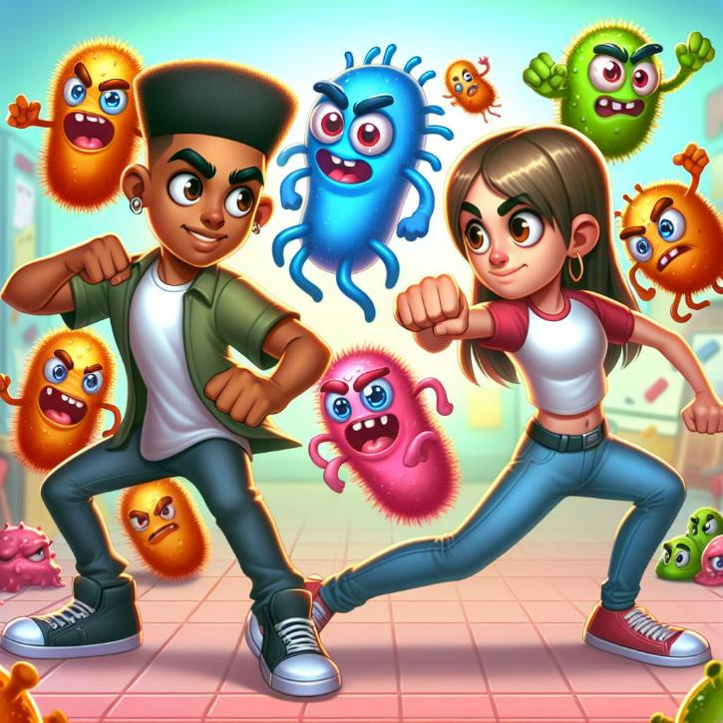
Immune system
The word “immune” means to be protected.
It would make sense that the body’s defences would fight off sicknesses, hence it is called the immune system.
The immune system is made up of cells, tissues, and organs that work together to make sure your body is protected.
Notes:
the immune system defeats any harmful microbes entering the body, however, in some cases the immune system needs help. Antimicrobials are medicines used to kill or slow the growth of microbes and antibiotics are special medicines used by doctors to kill harmful bacteria. Some antibiotics stop the bacteria reproducing and others kill the bacteria.

Slide 5
What are antibiotics?
Antibiotics are drugs that kill bacteria germs. They can only treat sickness caused by bacteria, also known as a bacterial infection.
This includes strep throat, urinary tract infections (UTI) and many skin infections.
Antibiotics don't work on sickness caused by virus germs, also known as a viral infection such as common colds, flu, chickenpox, measles etc.
Antibiotics work on bacteria
Notes:
Antibioitcs are used in the treatment of minor and potentially life-threatening infections in humans and animals
In 1928 Alexander Fleming went on holiday and left some laboratory agar plates from an unrelated experiment out on his desk. When he came back from holiday he discovered that the bacteria growing in his agar plates couldn’t grow near the mould that was also growing on the plate, he concluded that the mould had produced a chemical to protect itself from the bacteria using an antibacterial agent. Scientists used this new chemical to develop antibiotics.

Slide 6
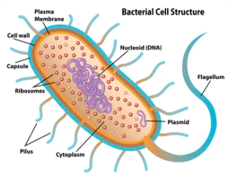
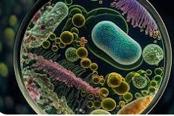
Antibiotics
Work in different ways.
Different antibiotics target different parts of bacterial cells - The cell wall is a major target.
May not work on some because of difference in bacteria
Notes:
There are many types of antibiotics but not all of them work in the same way. So, when antibiotics are being used it may not be a correct match to treat the bacteria infection. for instance, penicillin, kills bacteria by destroying the bacterial cell wall. Others, such as tetracycline, interfere with the ability of bacteria cells to reproduce or make proteins or nutrients they need to survive. Doctors choose an antibiotic based on the bacteria that often cause a certain infection.

Slide 7
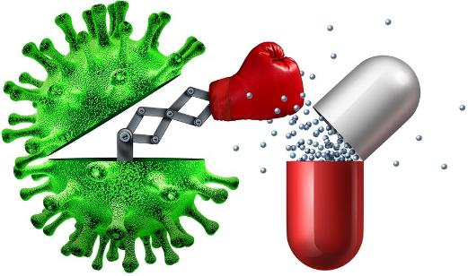
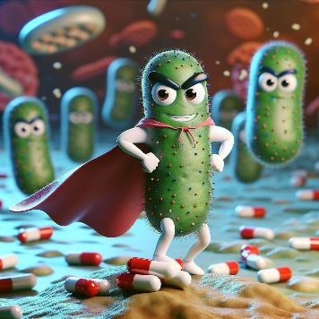
What is Antimicrobial Resistance?
When bacteria evolves new characteristics that mean they cannot be killed by antibiotics, the bacteria have developed antibacterial resistance.
GCSE Biology - What is Antibiotic Resistance? Why Antibiotic Resistance is a HUGE issue #81 - YouTube
Every living thing, including bacteria, undergoes natural changes to its DNA. Sometimes these changes give bacteria mechanisms that protect them from antibiotics.
Notes:
overuse and misuse of antibiotics has led to bacteria developing resistance to antibiotics through natural selection (survival of the fittest).
Before antibiotics were invented, harmful bacteria were life threatening. Today, however, many bacterial infections are easily treated with antibiotics – but bacteria are fighting back. Through increased exposure to the antibiotics, bacteria are becoming resistant to them. This means that bacterial infections are once again becoming life threatening. Examples of antibiotics are penicillin, clarithromycin, doxycycline and amoxicillin.
It is estimated that by 2050, deaths linked to antimicrobial resistant infections could reach 10 million globally per year, surpassing deaths linked to cancer (O ’Neill, 2016). Antibiotic resistance occurs when bacteria develop or acquire mechanisms that prevent them from being eliminated by antibiotics (drugs used to treat bacterial infections). Antibiotic resistance is a growing threat to modern medicine; in addition to treatment of infections, antibiotics are important for medical procedures involving surgery, and are key in the management of conditions such as cancer and diabetes

Slide 8
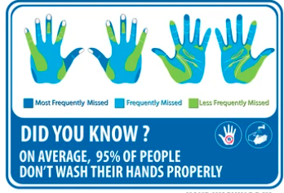
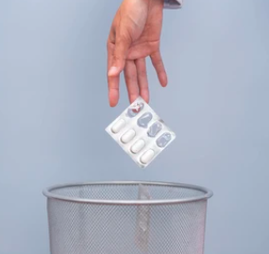
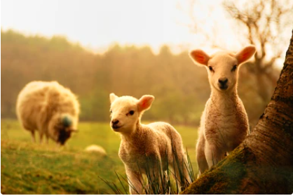
Causes of Antibiotic Resistance
Prescribing antibiotics when they are not needed.
Bad personal hygiene (e.g., not washing your hands properly) makes it more likely that you and other people will get sick.
Antibiotics in farm animals & in the environment
Create a selection pressure for resistant bacteria
May then be transmitted to humans.
Patients not finishing their treatment.
Notes:
Bad prescribing – can anyone think of an infection that’s caused by viruses? Antibiotics won't work for those (colds and flu).
The antibiotics tablets your given by your doctor are called a course – you need to take all of those because the full course should kill all the bacteria. If you don’t finish the course, not all the bacteria die, and some could become resistant.
Not washing your hands – more antibiotics have to be used – antibiotic resistance bacteria can spread through bad hygiene

Slide 9
Antibiotic Resistance Facts
It has been estimated that by 2050 there will be 10 million deaths a year worldwide due to antibiotic resistance.
In terms of time – one person, every three seconds.
Lots of medical procedures we may take for granted now would become too dangerous if we couldn’t treat infections.
Without action now – we could end up back in the stone age of medicine.
Antibiotics treat infectious diseases caused by bacteria, such as meningitis, tuberculosis, and pneumonia. They do not harm viruses, so antibiotics cannot treat diseases such as colds, flu and covid 19 which are caused by viruses.

Slide 10
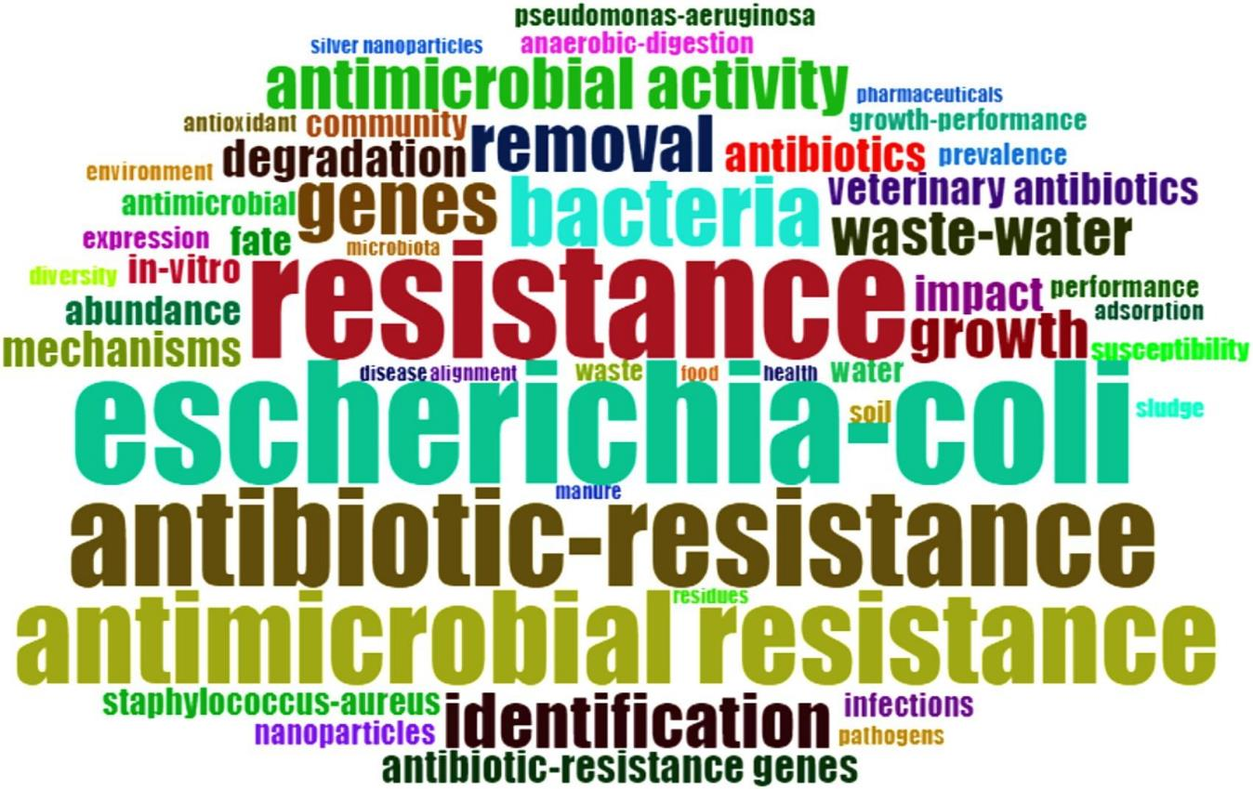
Notes:
Key Facts:
Antibiotic resistance is one of the biggest threats to global health, food security, and development today.
Antibiotic resistance can affect anyone, of any age, in any country.
Antibiotic resistance occurs naturally, but misuse of antibiotics in humans and animals is accelerating the process.
A growing number of infections – such as pneumonia, tuberculosis, gonorrhoea, and salmonellosis – are becoming harder to treat as the antibiotics used to treat them become less effective.
Antibiotic resistance leads to longer hospital stays, higher medical costs and increased mortality.

Slide 11
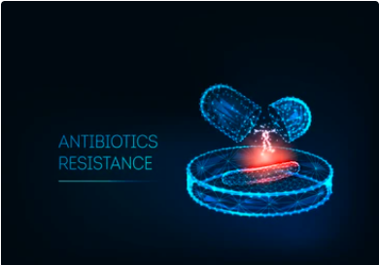
Why is tackling antibiotic resistance important??
It is rising to dangerously high levels in all parts of the world.
Where antibiotics can be bought for human or animal use without a prescription, the emergence and spread of resistance is made worse.
Similarly, in countries without standard treatment guidelines, antibiotics are often over-prescribed by health workers and veterinarians and over-used by the public.
New resistance mechanisms are emerging and spreading globally. Threatening our ability to treat common infectious diseases.
Notes:
Ask – why they think antibiotic resistance is an important problem?? Who does this affect? (1) People in hospital (2) very young and elderly people (3) if infections cannot be treated, people will die of diseases that are currently treatable.
prevent antibiotic resistance getting worse by:
a. only using antibiotics when prescribed by a health care professional (HCP)
b. finishing your course of antibiotics as recommended by your HCP
c. not using left over antibiotics (if for any reason you don’t finish your course of antibiotics, any left over should be given to your local pharmacy to dispose of)
d. not using antibiotics for most ear aches, sore throats or any colds or flu which are usually caused by viruses.
To confront AMR, the government have created a national action plan, ‘Confronting antimicrobial resistance 2024 to 2029’, which builds on the achievements and lessons of the previous and has 9 strategic outcomes organised under 4 themes.

Slide 12
Without urgent action, we are heading for a post-antibiotic era, in which common infections and minor injuries can once again kill…

Slide 13
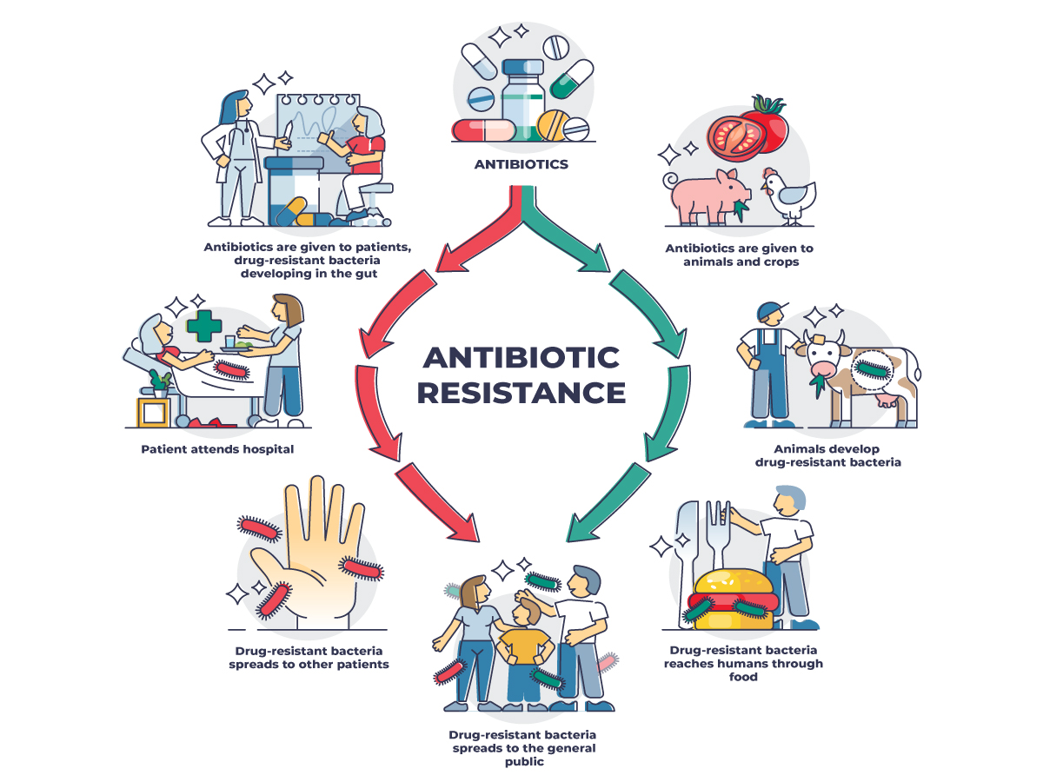
Notes:
Explain how antibiotic resistance chain. Over use of antibiotics for animals. Antibiotics in farm animals and in the environment, create a selection pressure for resistant bacteria, which may then be transmitted to humans.

Slide 14
To prevent and control the spread of antibiotic resistance we can…
Only use antibiotics when prescribed by a certified health professional.
Never demand antibiotics if your health worker says you don’t need them.
Always follow your health worker’s advice when using antibiotics.
Never share or use leftover antibiotics.
Prevent infections by regularly washing hands, avoiding close contact with sick people, practising safer sex, and keeping vaccinations up to date.
Prepare food hygienically, (keep clean, separate raw and cooked, cook thoroughly, keep food at safe temperatures, use safe water and raw materials).
Choose foods that have been produced without the use of antibiotics for growth promotion or disease prevention in healthy animals.

Slide 15
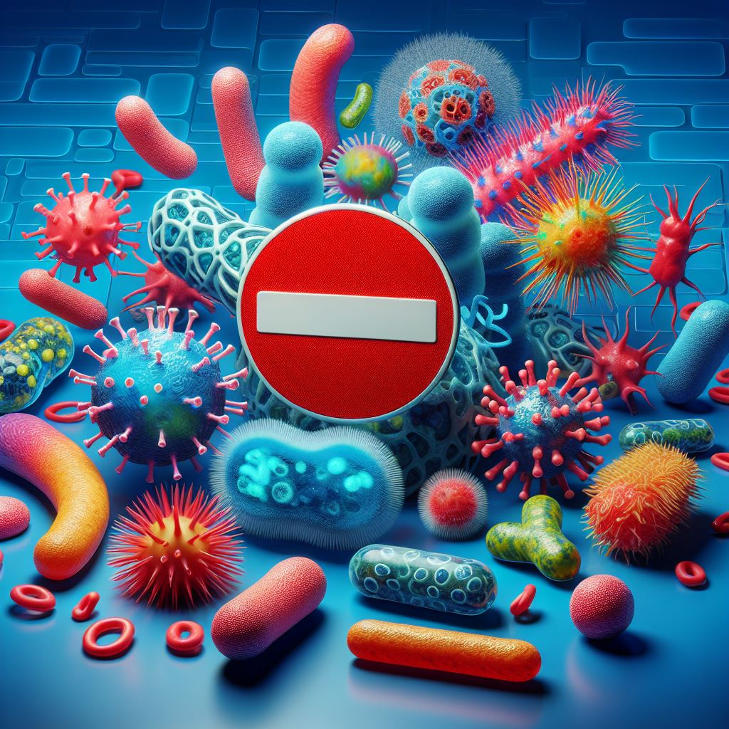
What are the government doing?
The second 5-year national action plan sets out ambitions and actions for the next 5 years in support of the 20-year vision for antimicrobial resistance (AMR) 2024-2029.
It includes 4 themes:
Theme 1 - Reducing the need for, and unintentional exposure to, antimicrobials
Theme 2 - Optimising the use of antimicrobials
Theme 3 - Investing in innovation, supply and access
Theme 4 - Being a good global partner
AMR is a natural phenomenon and a consequence of rapid evolution. It cannot be entirely prevented, therefore the focus is on containing, controlling and mitigating it, as set out in the UK 20-year vision for antimicrobial resistance (that by 2040 AMR is effectively contained, controlled and mitigated).
Notes:
Confronting antimicrobial resistance 2024 to 2029

Slide 16
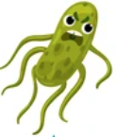
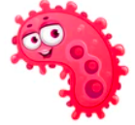
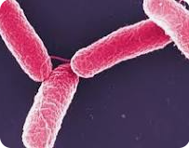
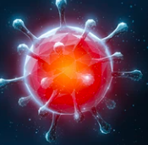
Introduction - Word game
Germs
Germs is a word used as an umbrella category which bacteria falls under. There are four major types of germs: bacteria, viruses, fungi & protozoa.
Microbe
Are living organisms too small to be seen with the naked eye; they are microscopic. Micro-organisms are found almost everywhere on Earth and can be both useful and harmful to humans.
Bacteria
Bacteria are among the smallest living things, the tiniest type of organism. They are microscopic, single-celled (or unicellular) organisms. They can survive on their own inside or outside the body.
Virus
Viruses are very small particles that can infect people and make them sick. Viruses invade a body’s cells and begin to multiply, they make the host sick, Viruses can cause all sorts of diseases. One of the most common is influenza which causes people to get flu. Other diseases caused by viruses include the common cold, measles, mumps, yellow fever, and hepatitis.
Notes:
Introduce words and students are asked if they know the words and discuss.

Slide 17
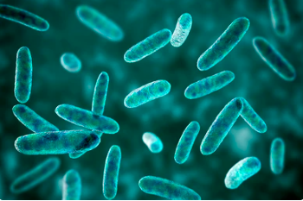
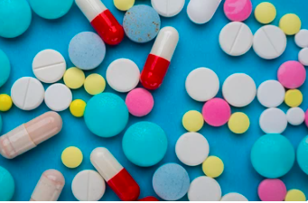
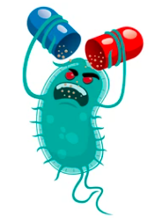
Introduction - Word game
Infection
Communicable diseases are those which are infectious. This means they can be spread from one person to another. The spread often happens via airborne viruses or bacteria. An example of this is the common cold.
DNA
DNA is the genetic code which makes up genes, which are responsible for giving an organism a specific characteristic.
Antibiotic
Antibiotics are medicines which kill bacterial infections.
Antibiotic resistance
Antibiotic resistance happens when bacteria change and become resistant to the antibiotics used to treat the infections they cause.
Notes:
Introduce words and students are asked if they know the words and discuss.
Non-communicable diseases are not infectious. This means they cannot be transferred between one organism and another. An example of this is chronic lung disease. Genetic diseases are also considered to be non-communicable. An example of this is sickle cell anaemia.
Vaccines protect us against viral infections.

Slide 18
RIGHT or Wrong
Notes:
CA -

Slide 19
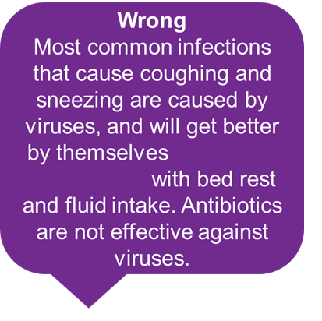
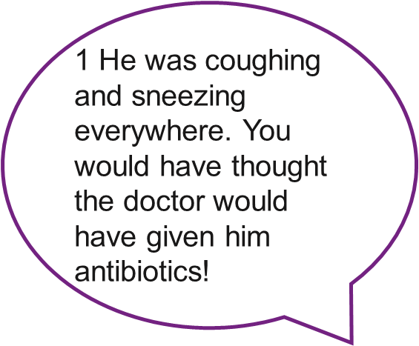
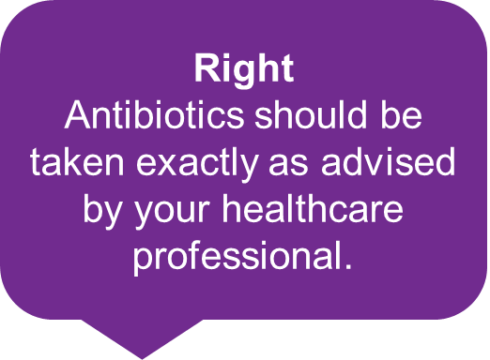
2 My doctor told me to
take my antibiotics for 5 days so that is what I did.

Slide 20
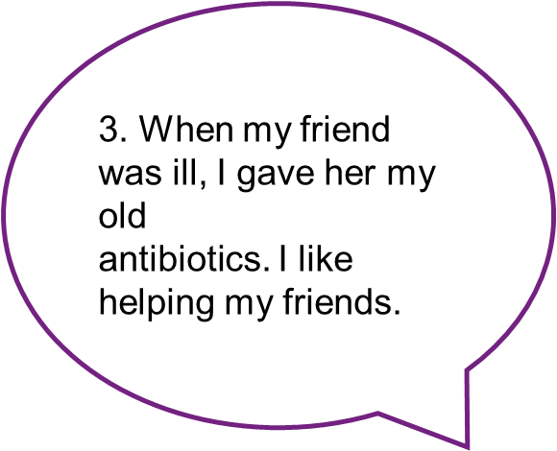
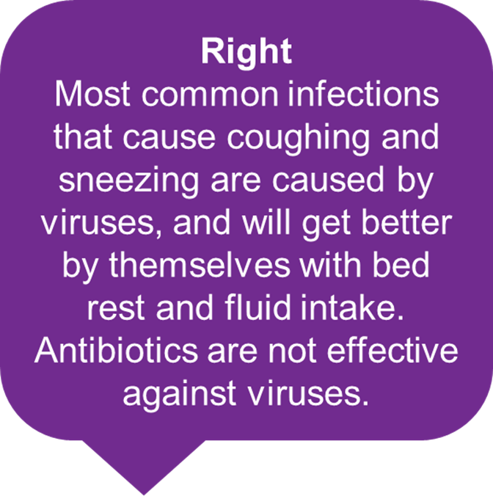
Wrong
You must not use other people’s or any leftover antibiotics.
4. Antibiotics don’t help
coughs and colds; you
just need bed rest, lots
of fluids and eat healthily.

Slide 21
Wrong
Antibiotics can help severe bacterial infections such as pneumonia or kidney/ urine infections.
5 All drugs are bad for you. I can’t see the point in taking antibiotics.
Wrong
Antibiotics should be taken exactly as advised by your healthcare professional.
6 My doctor gave me
antibiotics to take for 10 days but I feel better after 3 days so I’m going to stop taking them.

Slide 22
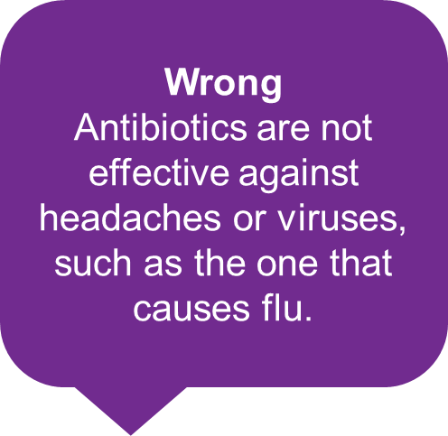
7 My headache and flu
symptoms are really
getting me down. I think I need antibiotics!
Right
If you over-use antibiotics they might not work when you really need them for a severe infection.
8 I don’t take antibiotics unless I really need them
as they might not work in the future.

Slide 23
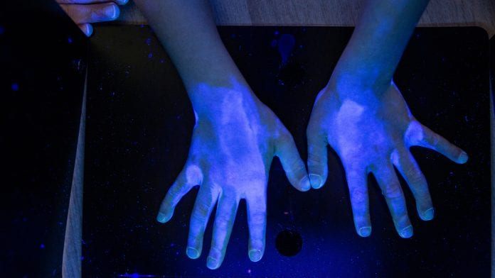
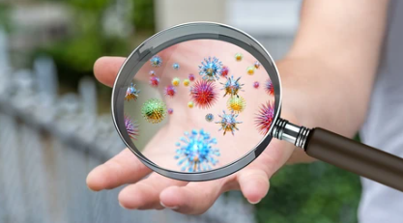
UV Light box activity

Slide 24
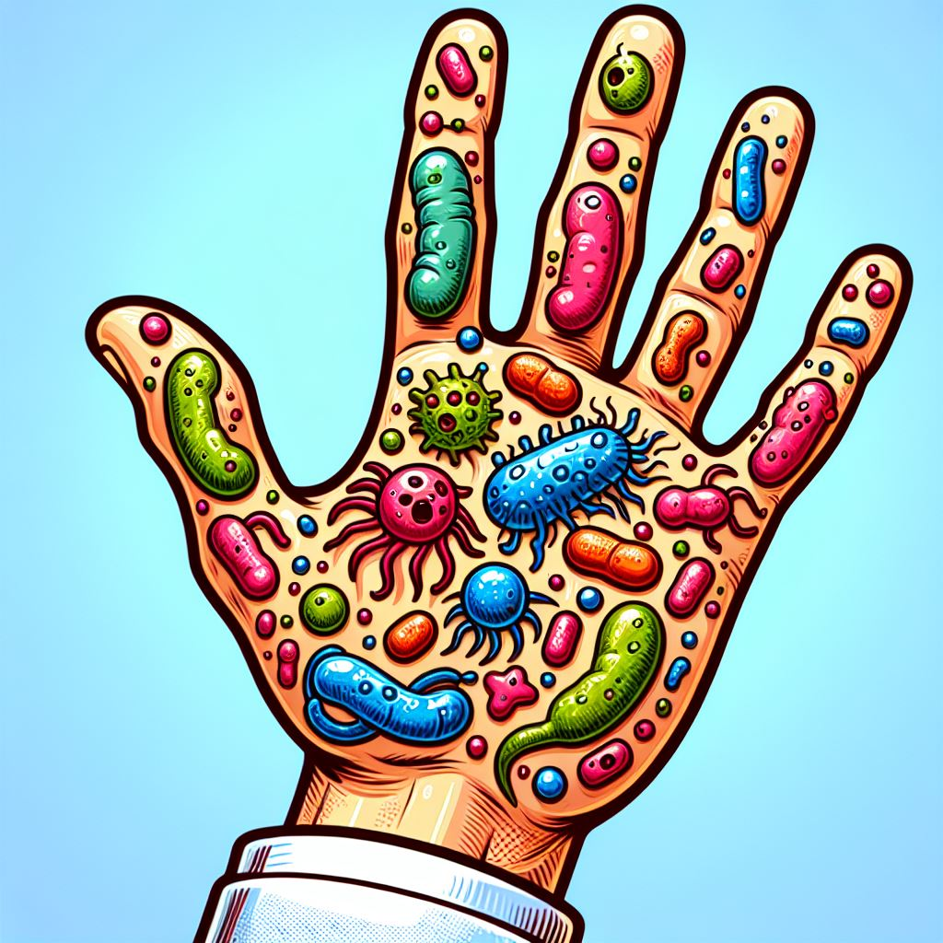
Any Questions?

Slide 25
References
Introduction to Microbes (e-bug.eu)
Antibiotic Awareness (Catherine E Rowland & Anna York) The university of Warwick.
World Health Organisation: World Health Organization (WHO)
Antimicrobial resistance - 2020 STUDENT FILM PRIZE of the Health for All Film Festival – YouTube
GCSE Biology - What is Antibiotic Resistance? Why Antibiotic Resistance is a HUGE issue #81 - YouTube

