Slide 1
LCC Epidemiology Study 2025
Jane Pearson: Project Lead

Slide 3
Survey aim and objectives
The aim of the survey is to provide comparable, local level information on the oral health of adults aged 65 years or older residing in a care home setting to guide local service commissioning and enable geographical comparisons.
The objectives of the survey are:
Sample and recruit people aged over 65 living in care home settings and undertake a clinical oral examination and questionnaire to estimate the prevalence of poor oral health amongst care home residents
Estimate population oral health status through clinical examination
Establish, by structured interview, reported experience of access to clinical treatment services, degree of dependency, the impact of poor oral health and need for mouth care support

Slide 4
Delivery requirements :
Visit a minimum of 6 sites per district (maximum of 10)
Examine a minimum of 100 residents over 65 years of age.

Slide 5
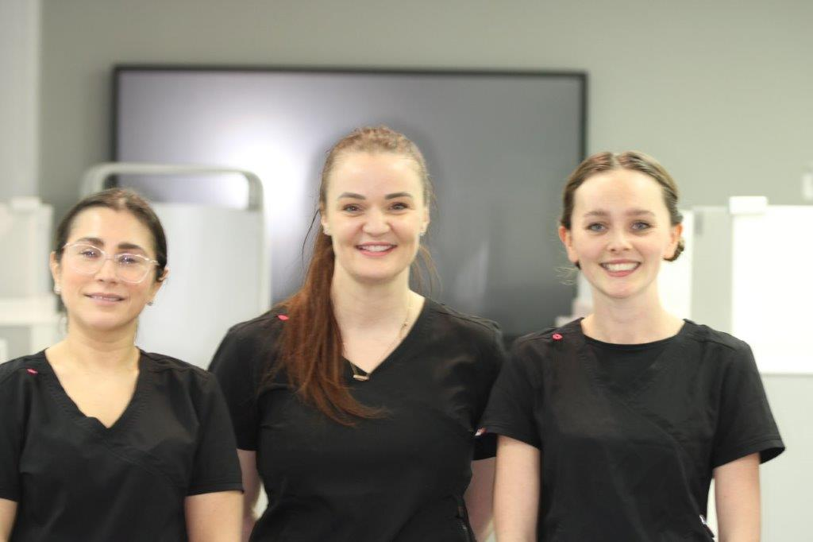
School of Dentistry Delivery Team

Slide 6
Thank you for your time if you any questions or further information required:
Dentalepidemiology@uclan.ac.uk
jpearson@uclan.ac.uk
01772 895870

