Slide 1
LCC Homecare Provider Forum 22nd January

Slide 2
Sourcing Homecare - Timescales

Slide 3
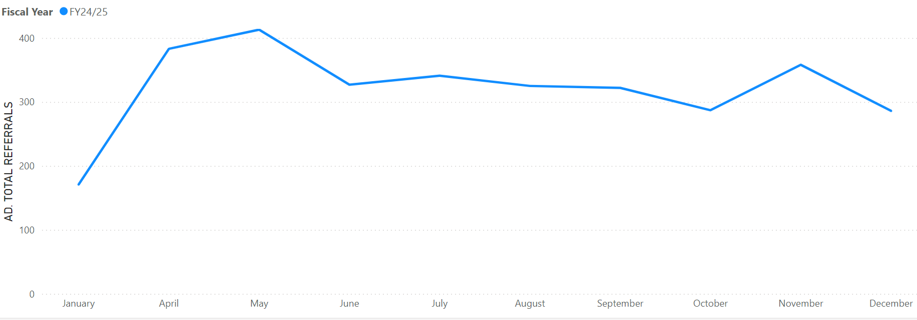
Homecare Referrals to Care Navigation

Slide 4
Numbers of People Receiving Homecare

Slide 5
Homecare Transfers update Jan 2025
Area | People | Hours (per week)
Lancaster and Morecambe | 6 | 194
East Lancs | 26 | 507.5
Central Lancs | 2 | 53
Fylde and Wyre | 9 | 256.5

Slide 6
New Developments
Round 2
Additional 37 providers joining March 24th
114 providers in total
In discussions around closing round 3
New E-Brokerage System 17th February
Informed does have functionality for you to change wards – possibly open every quarter
Fees – Uplift and Cabinet Item Feb 6th

