Slide 1
Last 1000 Days Improvement Collaborative
@BTHQIHub

Slide 2
Our Mission
To deliver safe, effective, sustainable care for everyone, every day.

Slide 3
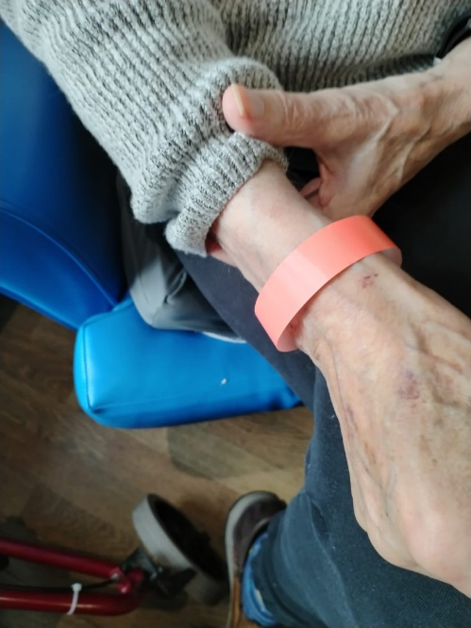
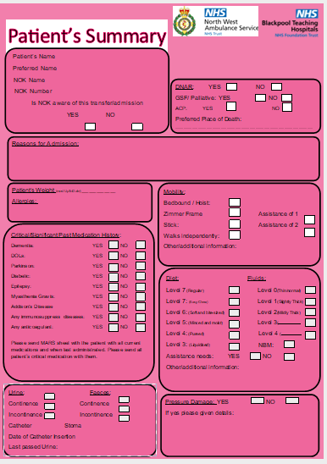
“Look at me” A Care Home communication tool and wristband - need-to-know information for residents' safety.

Slide 4
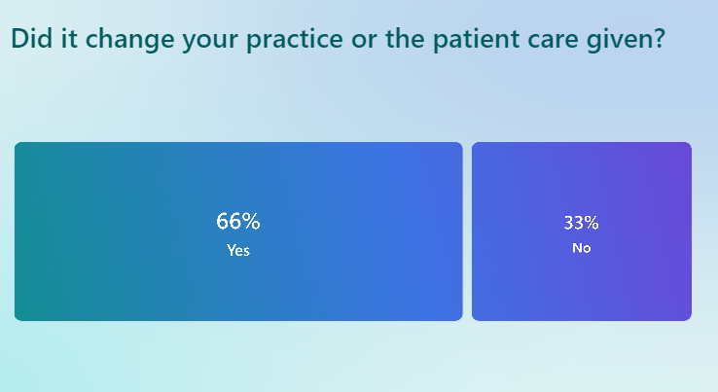
Look at me NWAS/ED 40 responses

Slide 5
Care practitioner feedback
Family member: I supported my grandad and it was comforting to know he was receiving the correct care and the pathway of care felt more organised.
hopsital dont appear to be ringing us much asking for information we have already given to them, allowing them time to care for the resident and not be calling us.
Reduces the amount of paperwork we have to produce, only MARs and 1 form instead of 27 forms
Yes, it is much more efficient and simpler with the most relevant information as opposed to Red Bag Relay's SBAR and RAF. The colour also stands out and is more noticeable for the people concerned in hospitals.

Slide 6
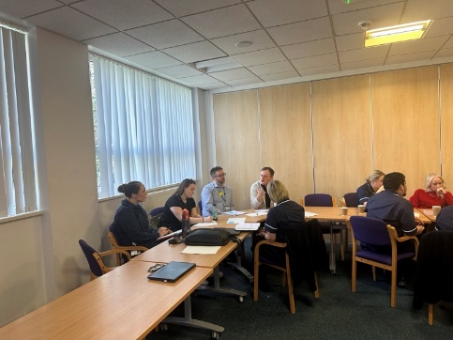
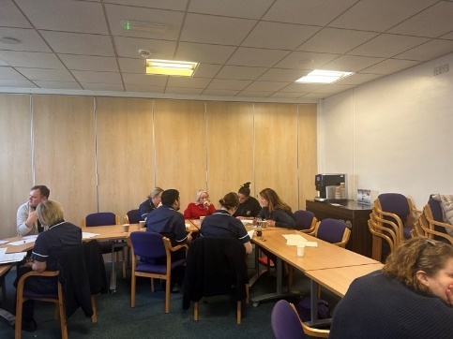
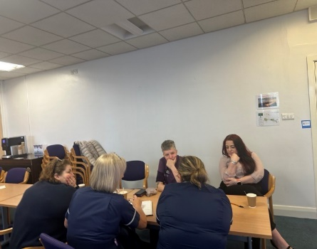
Co design Safe Discharge
Care Home Champions
Care Practitioner Discharge Document
Just to let you know that we had our first call today from the Care Home Champion, he was lovely, told me all about our resident, asked how often we wanted updates etc, Just thought it was worth a mention as the HCA was positive about it and it was lovely to hear! - Lexie Deputy Manager Fleetwood Hall

Slide 7
16th October 2024 9.30-1pm
Last 1000 days Phase 2
Trinity Hospice
To book a space please email
anna.dallow@nhs.net
Phase 3, are you interested?
anna.dallow@nhs.net

Slide 8
Would you like to be a part of the Phase 3, Last 1000 Days Quality Improvement Programme?
are you interested?
Need more information?
Could you help design the next phase?
anna.dallow@nhs.net

Slide 9
Professor Brian Dolan OBE, one of the UK’s most influential nurses, has invited five local community Care Home teams to speak at the international End PJ Paralysis 6th Global Summit next week. These care homes have been working with the Quality Improvement team at the Trust on the Last 1000 Days Quality Improvement Programme to ‘give back the gift of time to care home residents’ by reducing inappropriate Emergency Department attendances and improving safety within their care homes.
.
#EndPJparalysis Global Summit - End PJ Paralysis
Register here for free ☺

Slide 10
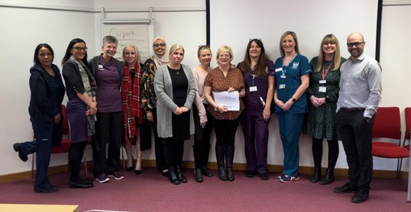
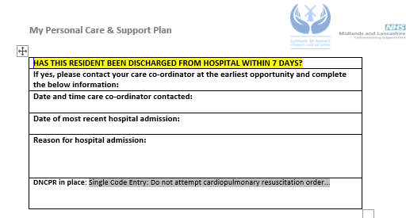
Personalised Care and Support Plans and Advance Care Plans
Lucy Cardwell, Frailty ACP at Trinity Hospice
- Aimed at supporting Care Homes and PCN’s to reduce avoidable admissions into ED for frail and palliative patients
- Working closely with the Lytham St Anne’s PCN Care Home Team and Care Home’s in LSA
- Re-design of the current care plan and advance care plan document to focus on clinical risks for high-risk residents recently discharged from hospital
- Currently on Version 2 of PCSP
- Tailored education sessions being developed based on feedback from care home staff

