Slide 1
Homecare Jan 2024
Policy, Information and Commissioning Team

Slide 2
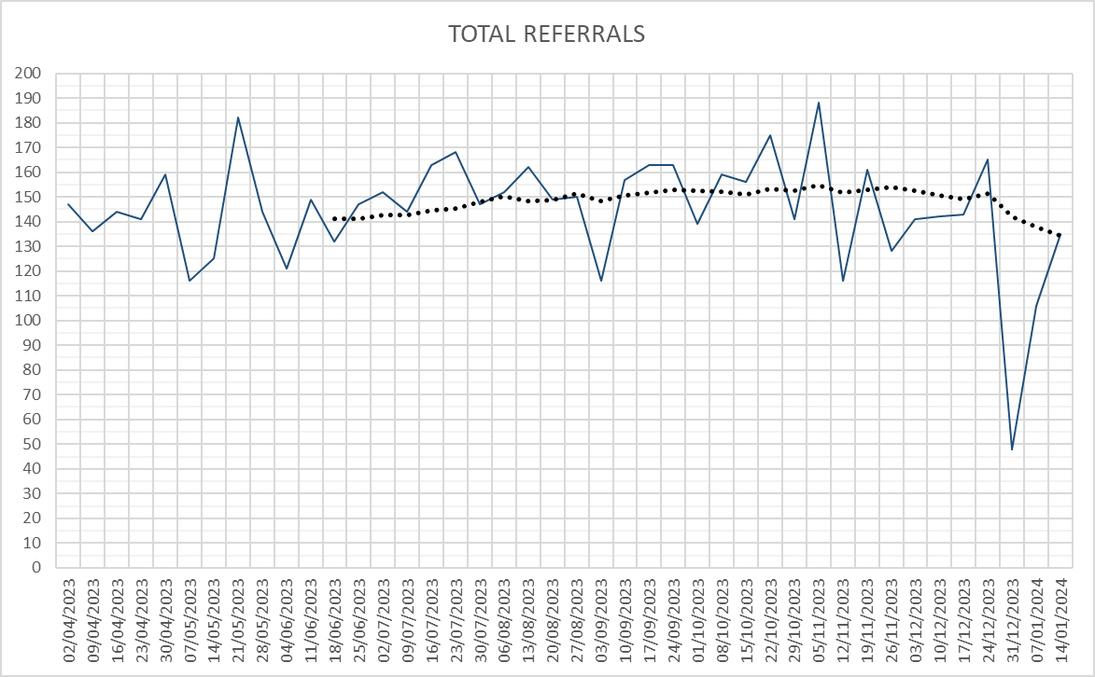
Total Referrals over Time

Slide 3
New People in December
Sourced via PDPS | 98.5%
Sourced ‘off PDPS’ | 1.5% (5 people)
Reasons | Specialist sign language needed (2), 2. wife of SU already received care from non PDPS provider, initially arranged by Health, now 50/50, transition from childrens services to adult services (initially commissioned by childrens)
Notes:
Contracting Arrangements – Open list, Pseudo Dynamic Purchasing System, providers can apply at any time. Proposing that this is open in April and then annually, no quality questions to be evaluated by a tender panel but must meet minimum requirements
Geography split by wards and also by client group – retain the 3 specialisms of Older adults/PDSI, Mental Health and Learning Disabilities / Autism. Providers can apply to be included in any of the 195 wards and also can be included in any number of the specialisms
Fixed Price – one hourly rate applicable to all specialisms and all wards
Moving away from time and task – will be a gradual move but aimed at being more flexible in our approach and giving providers more autonomy
Call-off arrangements – aim is to be as flexible as possible in determining which providers to award packages to and not be limited to one choice – e.g. could be rotation, SU choice, least distance to travel, can accept more than 1 package, etc

Slide 4
Numbers of Providers across Districts (All Categories)
District | No. Providers
Burnley | 31
Chorley | 28
Fylde | 28
Hyndburn | 34
Lancaster | 20
Pendle | 27
Preston | 34
Ribble Valley | 21
Rossendale | 19
South Ribble | 33
West Lancashire | 14
Wyre | 26
Notes:
Contracting Arrangements – Open list, Pseudo Dynamic Purchasing System, providers can apply at any time. Proposing that this is open in April and then annually, no quality questions to be evaluated by a tender panel but must meet minimum requirements
Geography split by wards and also by client group – retain the 3 specialisms of Older adults/PDSI, Mental Health and Learning Disabilities / Autism. Providers can apply to be included in any of the 195 wards and also can be included in any number of the specialisms
Fixed Price – one hourly rate applicable to all specialisms and all wards
Moving away from time and task – will be a gradual move but aimed at being more flexible in our approach and giving providers more autonomy
Call-off arrangements – aim is to be as flexible as possible in determining which providers to award packages to and not be limited to one choice – e.g. could be rotation, SU choice, least distance to travel, can accept more than 1 package, etc

Slide 5
Comparison – Pre PDPS and from 13th November
 | AVG REFERRALS / WK |  |  | CANCELLATIONS
 | PRE-PDPS | POST PDPS | VAR | PRE-PDPS | POST PDPS | VAR
CENTRAL | 50.1 | 48.1 | -2 | 13.47% | 17.27% | -3.80%
EAST | 43.1 | 36.0 | -7 | 10.30% | 11.33% | -1.03%
NORTH | 54.7 | 44.8 | -10 | 16.47% | 16.97% | -0.49%
Out of County | 0.5 | 0.3 | -0.2 | 26.67% | 66.67% | -40.00%
Unknown | 0.3 | 0.7 | 0.4 | 44.44% | 20.00% | 24.44%
COUNTY WIDE | 148.6 | 129.9 | -18.7 | 13.76% | 15.67% | -1.91%
Notes:
Contracting Arrangements – Open list, Pseudo Dynamic Purchasing System, providers can apply at any time. Proposing that this is open in April and then annually, no quality questions to be evaluated by a tender panel but must meet minimum requirements
Geography split by wards and also by client group – retain the 3 specialisms of Older adults/PDSI, Mental Health and Learning Disabilities / Autism. Providers can apply to be included in any of the 195 wards and also can be included in any number of the specialisms
Fixed Price – one hourly rate applicable to all specialisms and all wards
Moving away from time and task – will be a gradual move but aimed at being more flexible in our approach and giving providers more autonomy
Call-off arrangements – aim is to be as flexible as possible in determining which providers to award packages to and not be limited to one choice – e.g. could be rotation, SU choice, least distance to travel, can accept more than 1 package, etc

Slide 6
Hospital Referrals Vs Community Referrals
 | ROUTE OF ACCESS
 | AVG REFERRALS / WK |  |  |  | REFERRAL SPLIT
 | HOSPITAL |  | COMMUNITY |  | HOSPITAL |  | COMMUNITY
 | PRE-PDPS | POST PDPS | PRE-PDPS | POST PDPS | PRE-PDPS | POST PDPS | PRE-PDPS | POST PDPS
CENTRAL | 11.3 | 19.7 | 38.8 | 28.3 | 22.5% | 41.0% | 77.5% | 59.0%
EAST | 2.6 | 2.9 | 40.4 | 33.1 | 6.1% | 8.0% | 93.9% | 92.0%
NORTH | 11.5 | 8.6 | 43.2 | 36.2 | 21.1% | 19.1% | 78.9% | 80.9%
Out of County | 0.0 | 0.0 | 0.4 | 0.3 | 6.7% | 0.0% | 93.3% | 100.0%
Unknown | 0.0 | 0.1 | 0.2 | 0.6 | 11.1% | 16.7% | 88.9% | 83.3%
COUNTY WIDE | 25.5 | 31.2 | 123.1 | 98.6 | 17.2% | 24.1% | 82.8% | 75.9%
Notes:
Contracting Arrangements – Open list, Pseudo Dynamic Purchasing System, providers can apply at any time. Proposing that this is open in April and then annually, no quality questions to be evaluated by a tender panel but must meet minimum requirements
Geography split by wards and also by client group – retain the 3 specialisms of Older adults/PDSI, Mental Health and Learning Disabilities / Autism. Providers can apply to be included in any of the 195 wards and also can be included in any number of the specialisms
Fixed Price – one hourly rate applicable to all specialisms and all wards
Moving away from time and task – will be a gradual move but aimed at being more flexible in our approach and giving providers more autonomy
Call-off arrangements – aim is to be as flexible as possible in determining which providers to award packages to and not be limited to one choice – e.g. could be rotation, SU choice, least distance to travel, can accept more than 1 package, etc

Slide 7
Service User Transitions to PDPS
CENTRAL | EAST | NORTH
414 | 360 | 607
Notes:
Contracting Arrangements – Open list, Pseudo Dynamic Purchasing System, providers can apply at any time. Proposing that this is open in April and then annually, no quality questions to be evaluated by a tender panel but must meet minimum requirements
Geography split by wards and also by client group – retain the 3 specialisms of Older adults/PDSI, Mental Health and Learning Disabilities / Autism. Providers can apply to be included in any of the 195 wards and also can be included in any number of the specialisms
Fixed Price – one hourly rate applicable to all specialisms and all wards
Moving away from time and task – will be a gradual move but aimed at being more flexible in our approach and giving providers more autonomy
Call-off arrangements – aim is to be as flexible as possible in determining which providers to award packages to and not be limited to one choice – e.g. could be rotation, SU choice, least distance to travel, can accept more than 1 package, etc

