Slide 1
Introduction to ENRICH (Enabling Research in Care Homes) in the North West Coast Research Network
James Connolly and Kay Aymer
23rd March 2023
Notes:
LB

Slide 2
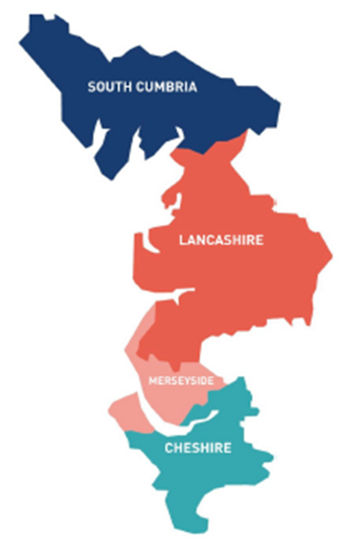
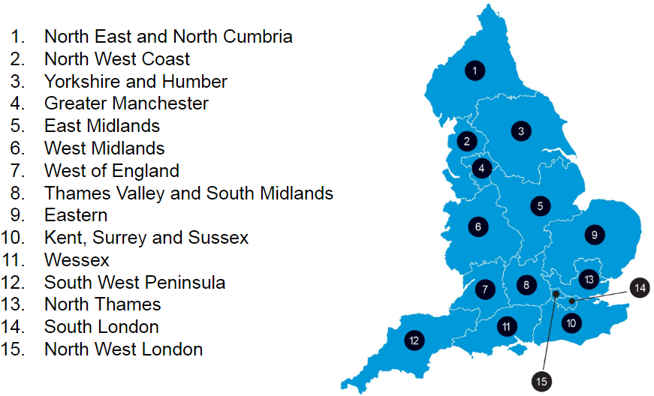
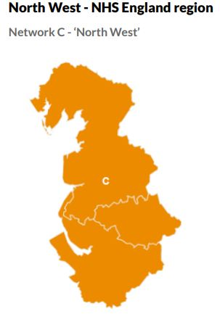
Current
Future
National Coordinating Centre (CRNCC)
15 Local Clinical Research Networks (LCRNs)
From April 2024 we will be known as North West Regional Research Delivery Network – incorporating Manchester - Population 7 million and covering 3 ICS’s

Slide 3
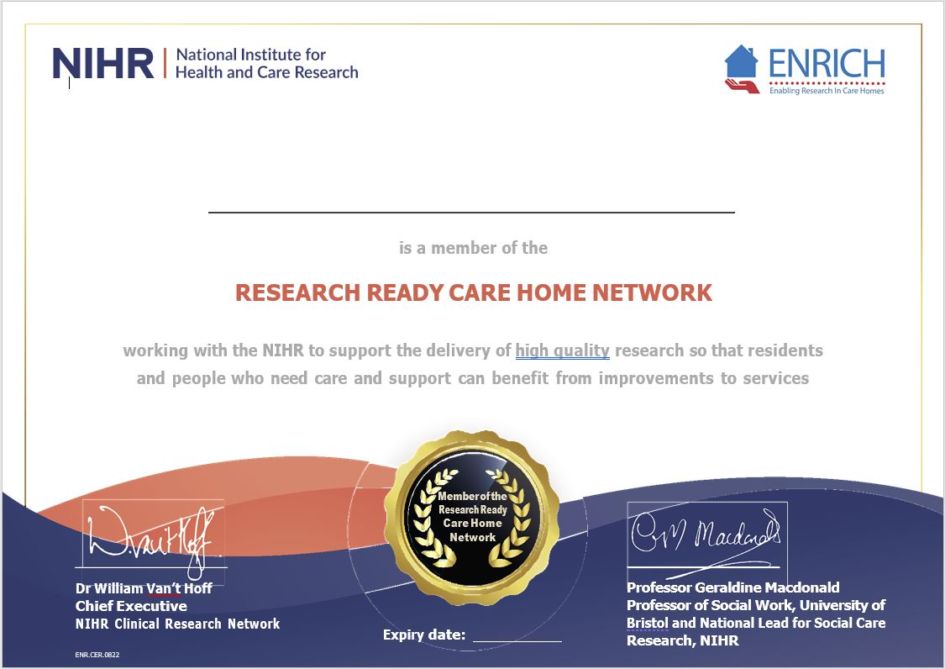
What is ENRICH?
A collaboration between the NIHR and care homes/ care home groups.
Opportunity to be involved in research
A voice to be able to shape future research.
A link to a wider network
ENRICH certificate
Please visit the national ENRICH website for further information - https://enrich.nihr.ac.uk/
Click here to sign up to ENRICH in the North West Coast Research Network

Slide 4
Single point of contact
Follow up and Close Down
Expressions of interest
NIHR ENRICH team can support with all aspects of being involved in research
Supporting with research delivery
Study set up (Paperwork)
Finance

Slide 5
Examples of NIHR studies with social care involvement
AFRI-C
Air filtration device study
AFRI-C study information
Express interest here
Measuring Loneliness
Survey study for viewpoints on loneliness
VOICE
Views on Incontinence Care in Care Homes
NAMASTE Study
Study team would like to speak to care homes before opening up
Notes:
LC

Slide 6
CRN NWC ENRICH
Performance Overview 2022/2023
^{6th} LCRN
100% Integrated Care Boards
22 Care homes
95 Recruits
15 Specialties
45 Care homes signed to ENRICH
12 Studies

Slide 7
NIHR North West Coast Contact Information
For any queries or interested in further information please contact us via enrich.crnnwcoast@nihr.ac.uk (generic inbox for care homes in the North West Coast)
James Connolly – ENRICH Lead for North West Coast Research Network – james.Connolly@nihr.ac.uk
Kay Aymer – Research Officer – kay.aymer@nihr.ac.uk
Notes:
LC

