Slide 1
Cleaning Standards Forum

Slide 2
Introduction
Housekeeping
Presentation/activities
Evaluation forms

Slide 3
Aims
Objectives
You will learn the best approach to cleaning and why it is important in reducing Health Care Associated Infections (HCAI)
Introduce the new cleaning standards Nov 22
You will learn the science behind good cleaning practices
You will learn how to clean surfaces with wet wipes/disinfectant products in the clinical/ care home setting
By the end of the session you should be able to:
Set the standard of cleanliness to be achieved
Identify who has overall charge of cleaning
Identify the frequency of cleaning areas and equipment
Identify colour coding for different areas

Slide 4
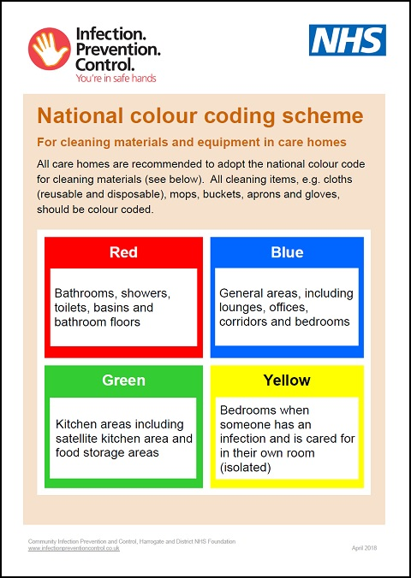
Why must we clean?
In acute settings in England and Wales 1:16 patients (6.4%) will acquire a Health Care Associated Infection (HCAI). Patients are 7 times more likely to die if they have an HCAI.

Slide 5
Activity 1
Notes:
Group discussion – around roles and responsibilities, common missed areas or issues, common issues found in IPC audits

Slide 6
Introducing new cleaning standards
https://www.england.nhs.uk/wp-content/uploads/2021/04/B0271-national-standards-of-healthcare-cleanliness-2021.pdf
https://www.england.nhs.uk/wp-content/uploads/2021/04/B0271-national-standards-of-healthcare-cleanliness-2021-appendicies-april-2021.pdf
https://www.property.nhs.uk/news-insight/news/new-cleaning-standards/
Notes:
Discuss new cleaning standards – appendix 1 within the second link of the document
It will need to be adapted to your setting as some of the points will not be applicable
Please work alongside your cleaning schedules that are already in place.
Please look at how the new auditing system will be adapted from your current auditing regime.
Discuss LCC pilot.

Slide 7
Notes:
Are you surprised how long bugs can continue to live in the environment ? This could mean that if cleaning in the room of person with Norovirus is not optimal, they could become symptomatic again a few days after the first episode.

Slide 8
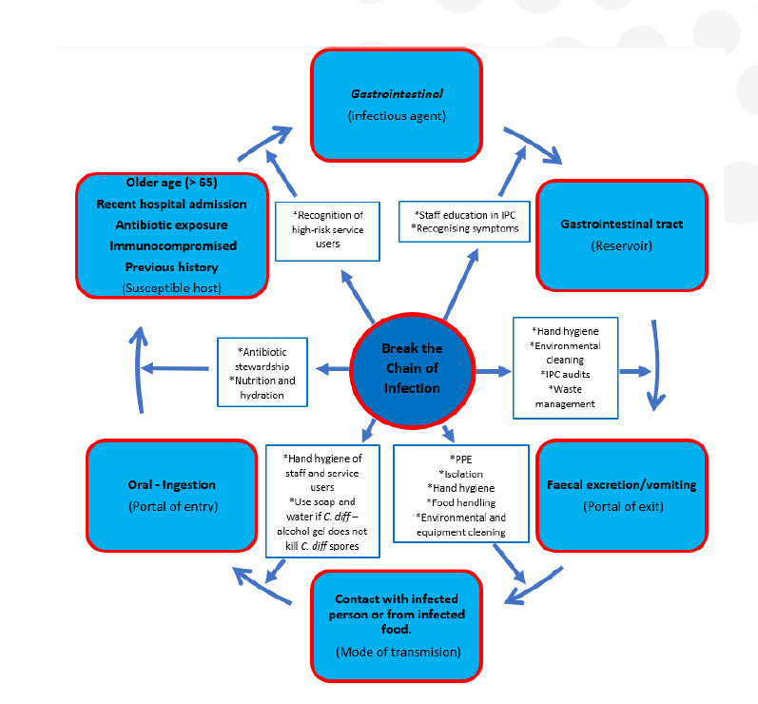

Slide 9
Activity 2
Notes:
D&V- scenario – not adding extra cleaning measures and D&V restarting.

Slide 10
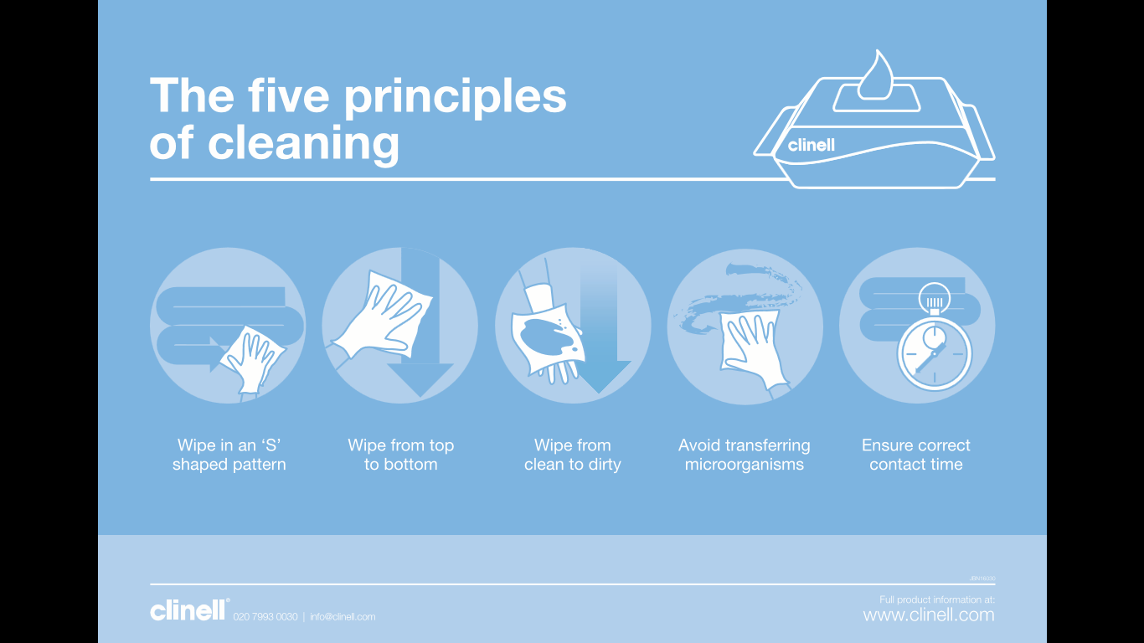
Five principles of cleaning
Notes:
For optimal cleaning, the 5 principles should be followed routinely so that it becomes second nature.

Slide 11
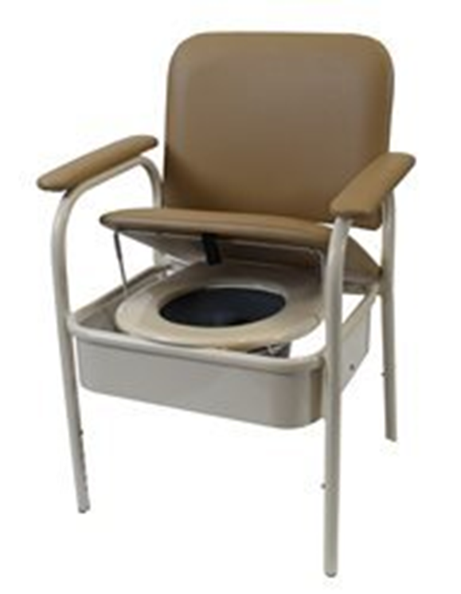
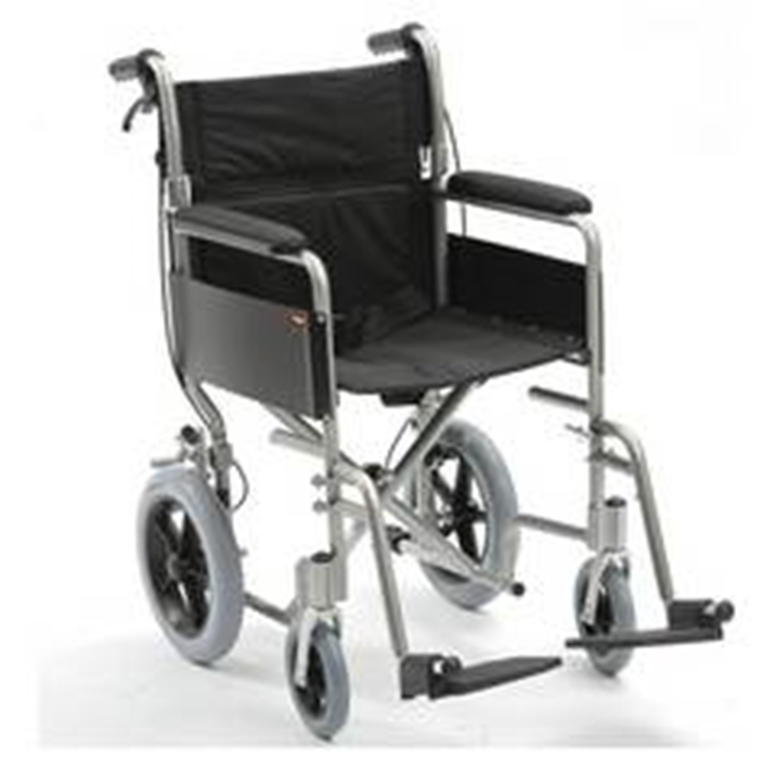
Cleaning of equipment
Notes:
Show video of how a commode should be cleaned effectively
Volunteers to clean – ensure PPE and cleaning wipes

Slide 12
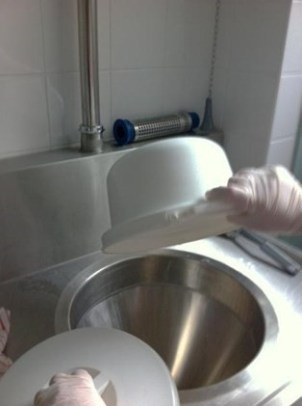
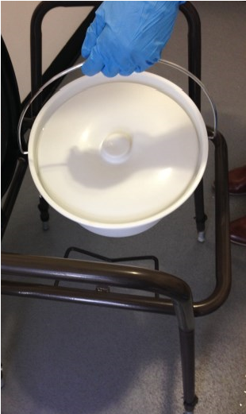
Cleaning and disinfecting a commode and pan manually
Perform hand hygiene before donning PPE Wear eye protection if there is a risk of splashing to the eyes.
Cover commode pan with lid and carefully remove from the commode to avoid spillages. Empty contents into en-suite toilet in the residents room or
Transfer the covered commode pan to the sluice room the contents into the waste disposal, if not disposed of in toilet.
Rinse the pan with cold water or place in the bedpan washer (if available) Immerse the cloths or wipes into the chlorine solution and squeeze the excess solution out.
Wipe the outside of the pan first then the inside do not dry with paper towels but leave inverted to dry naturally (Contact time)
Dispose of the cloth into clinical waste bin
Notes:
Use 1,000 ppm of the chlorine-based disinfectant solution used in the care Home (One tablet in one litre of cold water)
Use a bucket or sink designated for only cleaning commodes in the sluice or dirty utility room
Use disposable cleaning cloths and dispose of after use.
Pans should be replaced when scratched, stained or the handle is rusted Follow your local ‘Safe disposal of waste Policy’ for appropriate waste stream to be used.

Slide 13
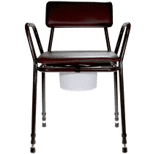
Cleaning the Commode
*****Dispose of cloth after each step.
1.Using either the Chlorine solution or wipes, start wiping the commode at the top of the backrest, front and back and work down to the seat-
2. Clean the arms
3. Clean the top side of the seat
4. Clean the toilet seat top and underside-
5. Clean legs –
6. Replace pan into holder.
7. Clean the seat cover top side first then underside and leave propped up to dry.
8. Replace seat cover when dry.

Slide 14
Products
You should never mix different types of cleaning/disinfecting products (unless specified by the manufacturer) as the chemicals may react with each other and may produce harmful gases. Use each product as recommended by the manufacturer.
Any made-up solution should be discarded after 24 hours. Make up a new solution every day.
Always use the products provided at your place of work. Don’t bring in your own cleaning products from home.
Notes:
Use correct cleaning codes for products
Please look for the BS EN on the bottle. This is usually displayed on the label and can be located on the front or on the back of the product. If the chosen product includes mention of compliance with BS EN 14476, this confirms the product to be effective against viruses such as Coronavirus (COVID-19).
Products compliant for E- coli 0157 and Salmonella Bacteria should have the numbers BS EN 1276 or 13697.
Products must be used at the recommended dilution rate and contact time to be effective, please follow manufacturer guidance.
Please remember when choosing a product:
We would strongly recommend that any staff using chemical-based products (disinfectants) must receive adequate training in their use.
Pay attention to the contact time for the cleaner to be effective.
Make sure you and your staff follow the instructions for the product chosen.
If your chosen product needs to be diluted before use, make sure you use the correct dilution level.
Supervise staff to ensure that all requirements of the cleaning process are completed.
Remind staff regularly to clean down surfaces, touch points, etc properly, use the right product, and following the instructions.
If using fogging machines, they should be additional to cleaning not as an alternative. Surfaces should be detergent cleaned prior to fogging.

Slide 15
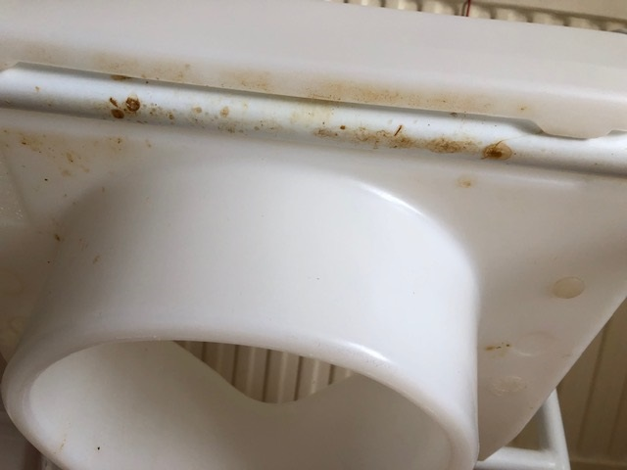
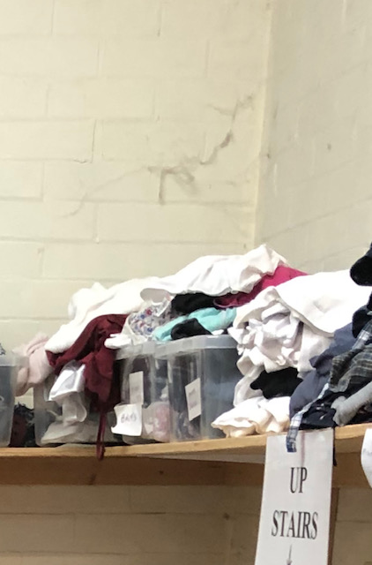
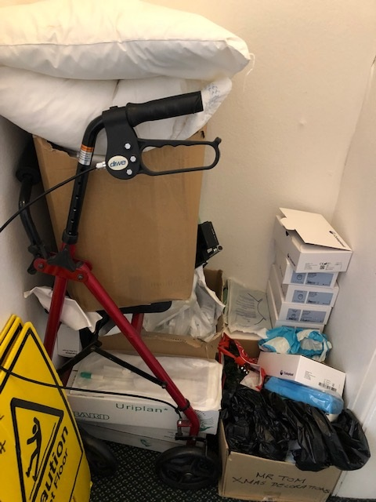
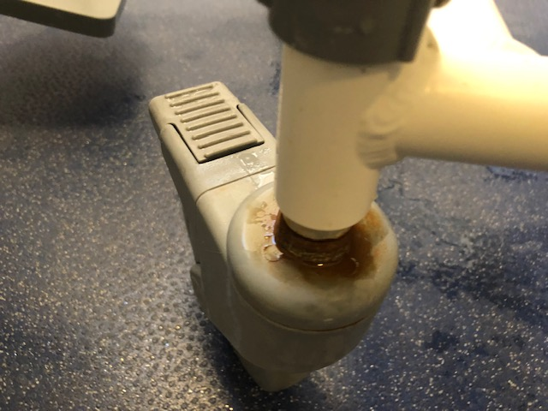
Activity 3
Notes:
Photo activity -

Slide 16
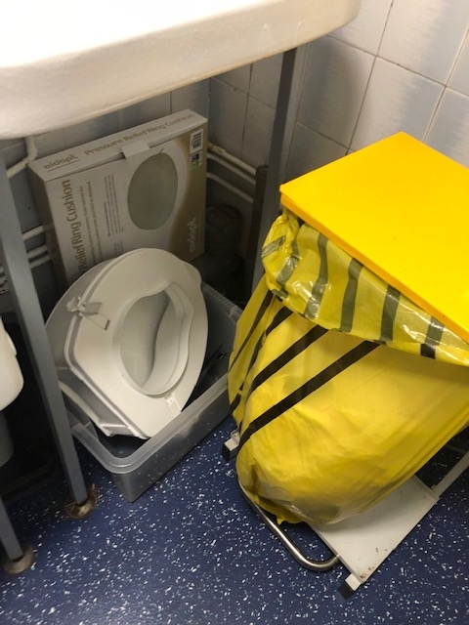
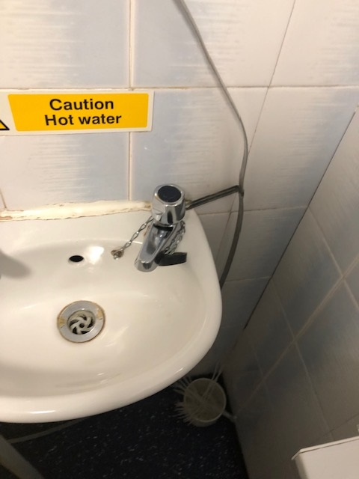
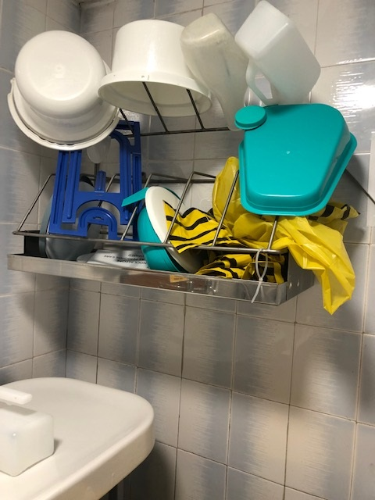
Activity 3

Slide 17
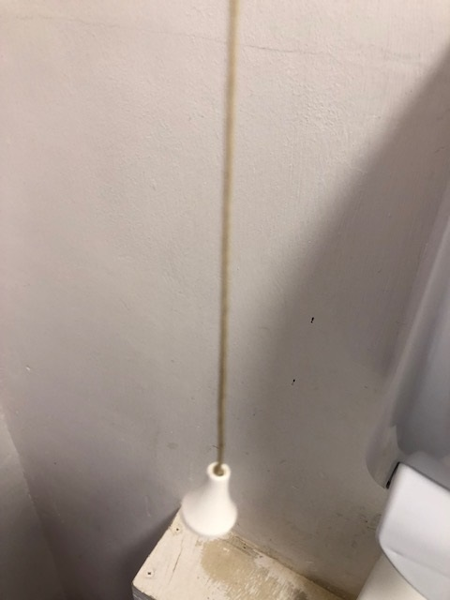
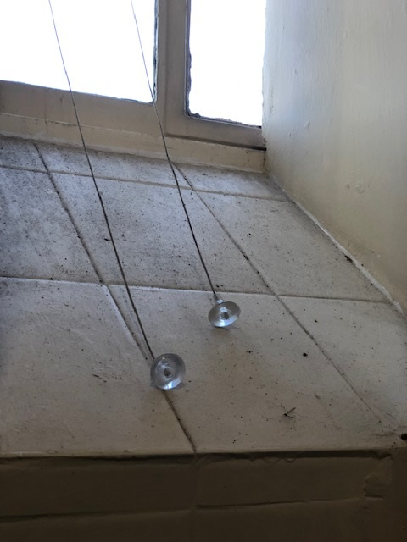
Activity 3

Slide 18
Decontamination of body fluid spillages
Place a caution sign at the spill
Don appropriate PPE; minimum gloves and apron.
Remove the main bulk of the spill from the area using paper towels/ blue roll, and placed into a clinical waste bag.
Use a chlorine product to thoroughly disinfect the area using the principles of cleaning and leave to air dry.
Remove the caution sign when the surface is completely dry
Notes:
Do not use towels/ bed linen for clearing excess fluid, as this increases the risk to other staff.
Do not place chlorine products directly onto urine or vomit as this can cause a potentially harmful vapour and will spread the spillage further. If a chlorine only product is used and once the contact time is complete, the area should be washed with detergent, rinsed and dried thoroughly.
Discuss use of mask for inhalation of vomit – chain of infection- hand hygiene

Slide 19
Notes:
The 5th moment highlights the importance of the decontamination of surfaces and equipment in the environment around the resident/service user and opportunity for hand hygiene

Slide 20
Cleaning schedules
Notes:
Why is it important to have cleaning schedules in place
Does your setting have clear roles and responsibilities outlined
Night to day cleaning rotas

Slide 21
Activity 4
Notes:
Embossed wallpaper
Smooth surfaces
Miscellaneous items in bathrooms
Sluices
Storage in bathrooms

Slide 22
Cleaning storage and equipment
Cleaning equipment also needs to be clean to avoid cross contamination
Equipment must be cleaned and dried between use
(mop buckets, cleaning trolleys)
Mop heads and cloths must be laundered daily or disposed of daily
Cleaning carts should have separation between clean and dirty areas
They should never have supplies of clothing, laundry or food and drink
Should be thoroughly cleaned at the end of the day or shift
Should be stored safely when not in use

Slide 23
To summarise
If something can be cleaned, then it needs to be on a cleaning schedule with audit.
The NPSA Guidance is a great resource for care homes - Adhering to it will help you to abide by the Health and Social Care Act -Regulation 12 cleanliness and infection control.
Deep Cleans following an outbreak take place 48 hours after the last symptomatic resident.
Think about staff rooms and office areas – remember they need cleaning too.
Look at our web page – lots of information there.

Slide 24
Any Questions

Slide 25
Evaluation Forms

Slide 26
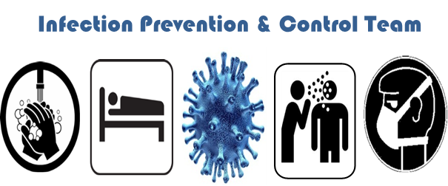
InfectionPrevention@lancashire.gov.uk
https://twitter.com/lancsipc

