Slide 1

Welcome to
Fire Prevention & Procedures
Important Note: This Powerpoint is designed to be viewed as a slide show.
If you are viewing this learning on a PC, please click on the ‘Slide Show’ tab at the top of your screen and select the icon:
Notes:
C4M7_01

Slide 2
Objectives
This module will teach you the basic processes and procedures to follow. Your line manager will talk you through what you need to know about the procedures for your local area, such as assembly points, extinguisher locations and evacuation procedures etc.
In this module you will learn about:
The causes of fire.
The Fire Triangle.
Fire prevention.
Fire procedures and equipment.
Fire reporting and evacuation procedures.
The role and duties of a Fire Warden.
This module should take you about 15 to 20 minutes to complete.
Notes:
C4M7_02

Slide 3
Introduction to Fire Prevention and Procedures
The outbreak of fire presents a potential emergency that could place you, your colleagues and other people at risk.
As an employee
You must be able to take the appropriate emergency action if fire breaks out.
You must know how to prevent a fire from starting.
Notes:
C4M7_03

Slide 4
The Fire Triangle
There are three main components necessary for a fire to start:
Fuel
Heat
Oxygen
Always remain alert to the possible causes of fire during your daily routine: protect yourself, your colleagues and other people by contributing to a safe working environment.
Did you know….by removing one of the elements in the fire triangle the fire cannot exist.
Notes:
C4M7_04

Slide 5
Common Causes of Fire
Here are the most common causes of fire in the workplace:
Faulty electrical appliances or wiring
Portable heaters
Cooking: fat fryers, microwaves and toasters
Arson
Accumulation of combustible materials e.g. paper, waste
Flammable materials
Safety tip Smoke detectors should be checked regularly to ensure the batteries are not flat.
Notes:
C4M7_05

Slide 6
Fire Prevention
There are many things you can do to ensure that you are working in a safe environment with no risk of fire.
Do not allow rubbish, waste packaging, plastic trays or wooden pallets to build up, either in inside or outside of the building. Ensure all rubbish is placed in designated bins. | When electrical appliances are not in use, always make sure they are switched off at the mains, for example, kettles, toasters and microwaves in the kitchen area. | Always carry out visual inspections of equipment prior to use. Check the flex, plug and socket to ensure it is in good condition. Always report any faulty wiring or electrical fault to your manager. | Always ensure fire doors are kept closed (not propped open) – they can prevent a fire spreading. Ensure fire exits are kept clear from obstructions and are unlocked whilst the building is occupied.
Notes:
C4M7_06

Slide 7
Using Different Types of Equipment
If you do attempt to put a fire out you must use the correct fire fighting equipment e.g. fire blankets, fire extinguishers.
You will find that all the new fire extinguishers are coloured red with a small coloured label showing their content.
Remember, it can be very dangerous to use the wrong extinguisher, so always be certain you choose the correct one for the type of fire and familiarise yourself with the operating instructions.
Did you know? If a person’s clothing is on fire then a fire blanket is the best piece of equipment to use. If you use a CO2 fire extinguisher, you could suffocate them and give them freeze burns internally and externally.
Safety tip!
You should only attempt to tackle a fire if: You have already raised the alarm; The fire is small and it is safe to do so; The fire is blocking your only means of escape. The county council’s policy is to raise the alarm and exit the building as quickly as possible.
Notes:
C4M7_07

Slide 8
Types of Equipment
Carbon Dioxide (Black Label) Fires which involve live electrical equipment (of any voltage) or flammable liquids | Powder (Blue Label) Fires which involve low voltage live electrical equipment or flammable liquids. | Foam (Cream Label) Fires involving liquids such as petrol, oils, greases and fats. | Water (Red Label) Fires involving materials like wood, fabrics, paper etc. Water must not be used on flammable liquids (white sprit, petrol, oil etc), or electrical fires. | Fire Blanket Fires which need to be smothered. E.g. used on pan fires and when a person’s clothes are on fire, to smother out the flames.
Notes:
C4M7_08

Slide 9

Fire-fighting Equipment
Did you know?
The county council has arrangements in place for fire extinguishers to have a service inspection annually by a competent contractor.
Notes:
C4M7_08

Slide 10
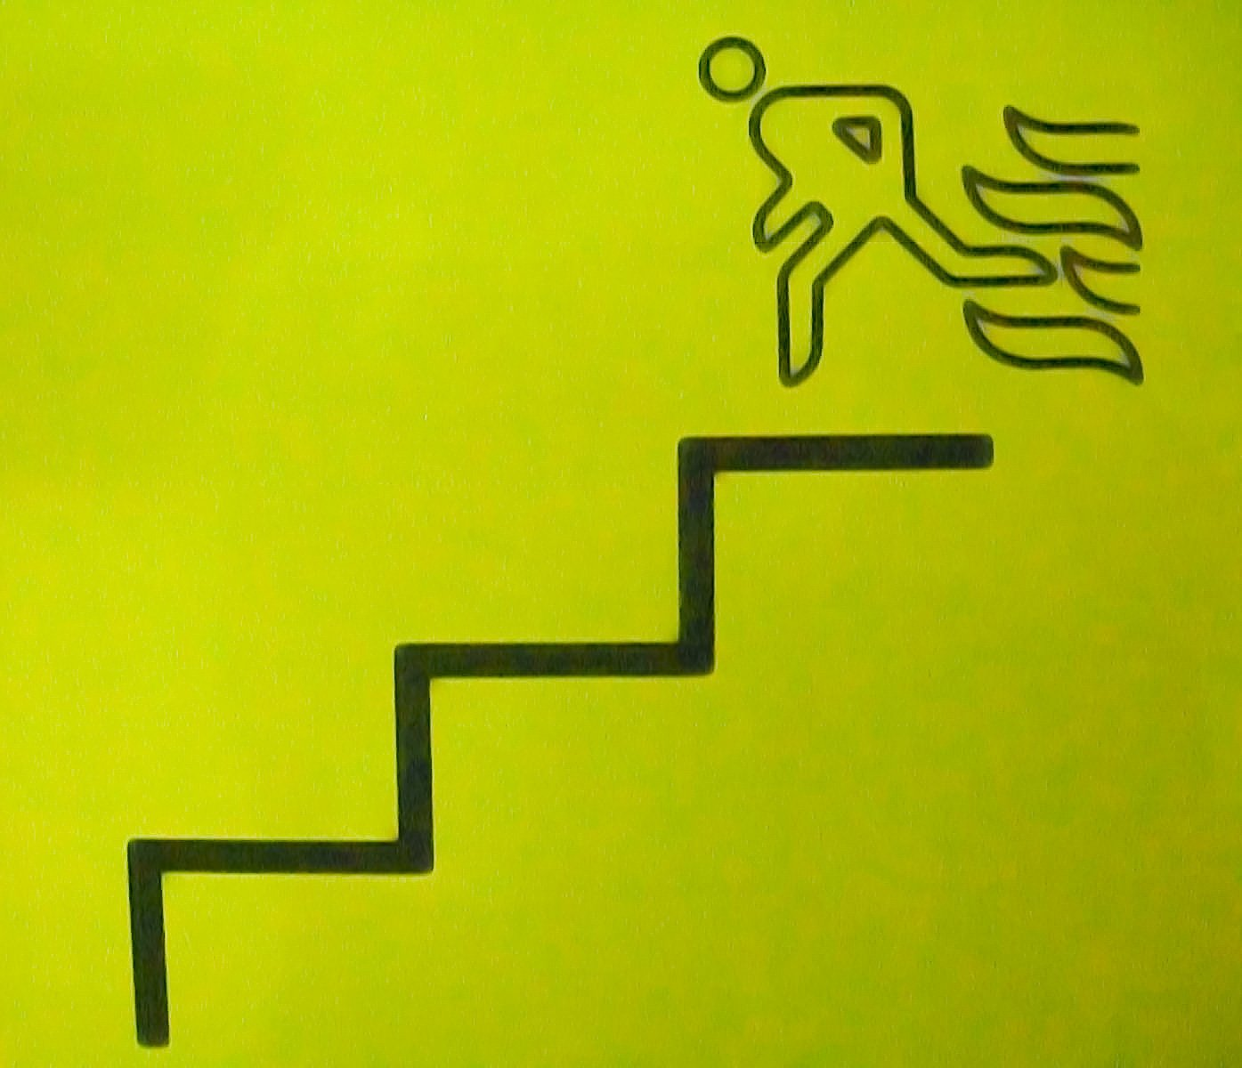
Fire Evacuation Procedures
If you discover a fire
Keep calm
Raise the alarm immediately
Evacuate the area
Go to the assembly point
Do NOT:
Obstruct fire doors
Stop to collect personal belongings
Use the lift
Re-enter the building until instructed to do so
Make sure you know:
The nearest fire exit
The nearest fire alarm call point (normally next to the fire exit)
Where the fire extinguishers are located
What you should do if there is a fire
Where your assembly point is
Notes:
C4M7_09

Slide 11
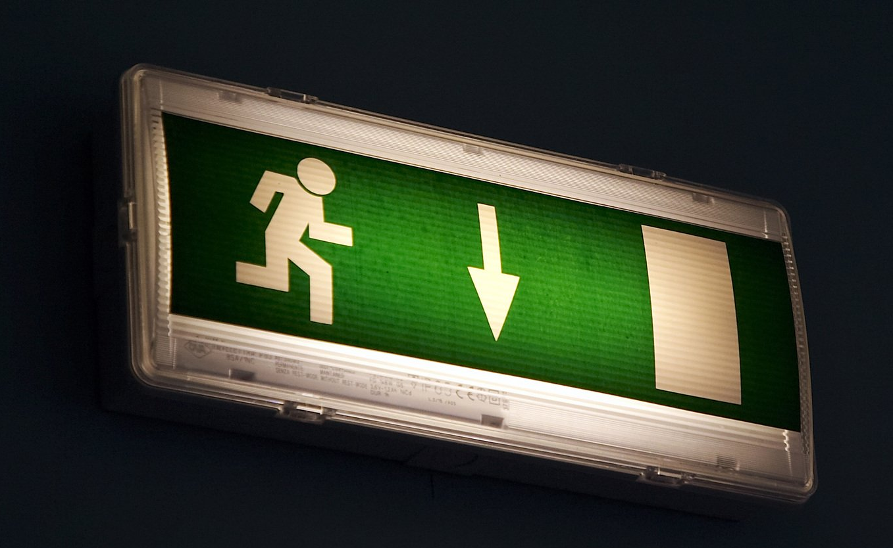
Fire Safety and Fire Evacuation: Local Arrangements
Your manager should make you aware of all local arrangements relating to fire safety & evacuation including those listed below
actions to follow if fire is discovered;
method of raising the alarm, including the method of operating fire alarm call points;
location of fire alarm call points;
local arrangements for summoning the fire brigade;
means of escape in the building, including those not in normal use, and the location of evacuation assembly points;
how to use any special exit hardware, such as panic bars;
action to follow on hearing the fire alarm signal in their building or establishment;
continued on next slide >
Notes:
C4M7_10

Slide 12
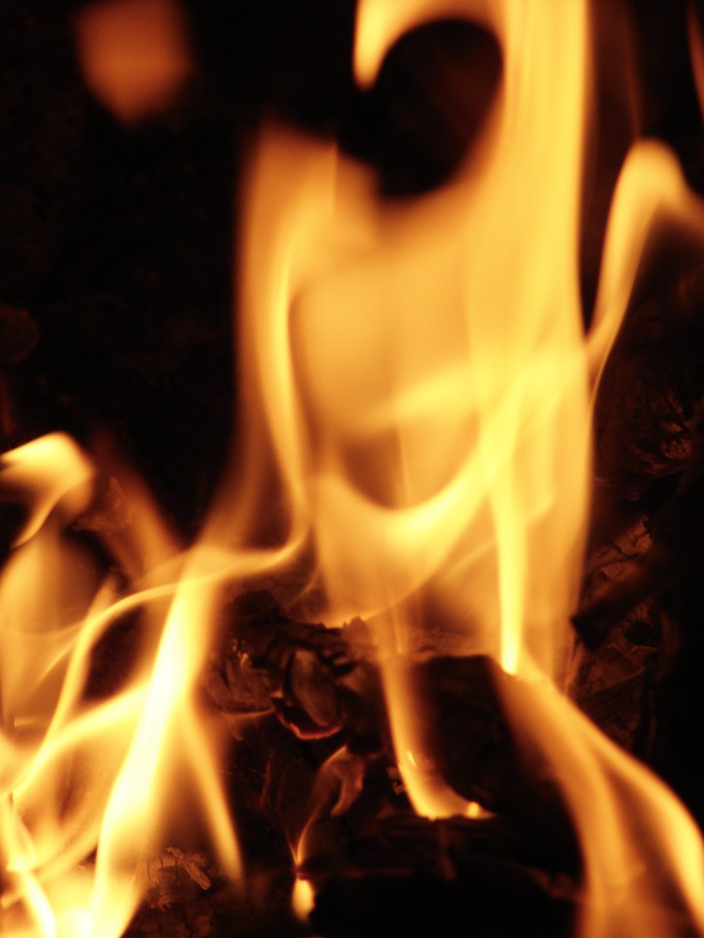
Fire Safety and Fire Evacuation: Local Arrangements cont’d
when alarm tests take place;
location of fire extinguishing appliances;
any specific arrangements for evacuating people with disabilities;
the purpose of fire precautions, such as fire doors, and the importance of not compromising these.
who the fire wardens are in your workplace and where to look for changes e.g. notice board, intranet.
If you have a mobility or other impairment (e.g. hearing or visual) which may affect your ability to follow the evacuation procedure you should approach your manager who will prepare a Personal Emergency Evacuation Plan (PEEP) with you.
Notes:
C4M7_11

Slide 13

Fire Reporting
It is important that any incidents of fire and near misses are reported using the LCC Accident/Incident Report Form, either via the HR Oracle system or by completing the form on the Health & Safety web site, so that they can be investigated and action taken to prevent them from happening again.
Notes:
C4M7_12

Slide 14
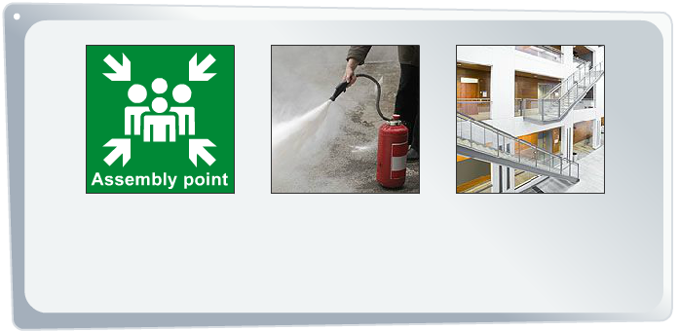
The Role of the Fire Warden
Some employees have additional duties with regards to fire and other types of evacuations. These employees are known as Fire Wardens (or Fire Marshalls) and they are appointed for LCC occupied premises by the Responsible Person for that building. The Responsible Person has overall responsibility for fire safety and in most cases it is the Premises Manager.
Fire Wardens are appointed to provide assistance in the event of an emergency evacuation by ensuring the safe and prompt evacuation of people from their area. This role may also include reassuring members of the public and providing an escort to leave the building.
Their role is NOT to fight fires and, like all employees, they should only use fire fighting equipment in an extreme situation, such as to assist in exiting the building.
Fire Wardens may have responsibility for the whole building, a floor, or just one area. The number of fire wardens required for a premises will depend on its size, the design and its use.
Notes:
C4M7_13

Slide 15
The Duties of the Fire Warden
The duties of a Fire Warden will depend on the location and service needs. For example; if a person works in a school the role may be different from a person who works in the County Hall complex. The main duties of a Fire Warden, without placing themselves at risk, are to:
Assist the safe and prompt evacuation of people from the building via the appropriate escape routes to the designated assembly points;
Provide assistance to those people who are experiencing difficulty (this may be prearranged e.g. an employee, or not pre-arranged e.g. a disabled visitor);
Inspect all rooms in their designated area(s) to ensure that no one is still in the building;
Report to the Responsible Person that their designated area(s) has been checked and is clear or is not clear. If it is not clear, the Fire Warden must supply the Responsible Person with the details of the location of anyone still in the building so the emergency services can be informed;
If the fire alarm is not linked directly to the Fire Brigade, in some instances, the Fire Warden will ring the emergency services.
Notes:
C4M7_14

Slide 16

Competency/Training
Fire Wardens should be competent to undertake the tasks expected of them. Instruction on how to undertake their tasks must be provided by their manager. The fire warden must understand what is expected of them and be able to do it.
This e-learning module forms part of the competency training for Fire Wardens, but it must be supplemented by local training on the specific arrangements in place at the premises where they are based.
Notes:
C4M7_15

Slide 17
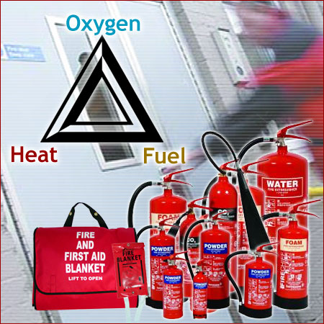
Summary
In this module we have looked at:
How fires can be started, the fire triangle and what can be done to prevent fires.
The procedure for dealing with fires and how to tackle them using the different types of fire extinguishers.
How to report fires and the evacuation procedure.
The role and duties of a Fire Warden.
Remember to ask your manager about the local fire safety and evacuation arrangements in your workplace.
Notes:
C4M7_16

Slide 18

Resources
You may find the following resources useful in relation to this topic.
Title & Web Site Links | Description
LCC Guidance on Management of Fire Safety: Schools Portal link Intranet link | LCC guidance on the management of fire safety in the workplace with links to related information, useful forms and templates.
LCC Fire Safety Log Book Guidance: Schools Portal link Intranet link | LCC guidance on fire related premises management aspects such as fire drill tests, the arrangements for the inspection, maintenance and testing of plant and equipment, with links to related information, useful forms and templates.
Notes:
C4M7_17

