Slide 1
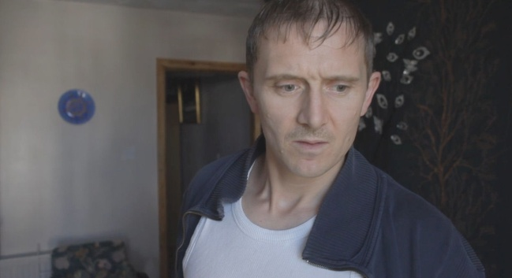
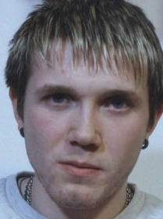
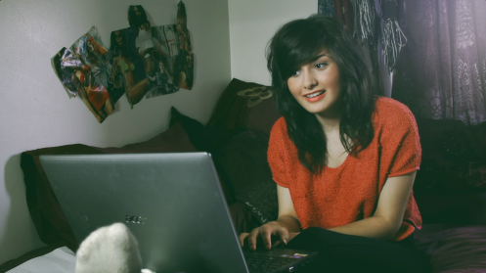
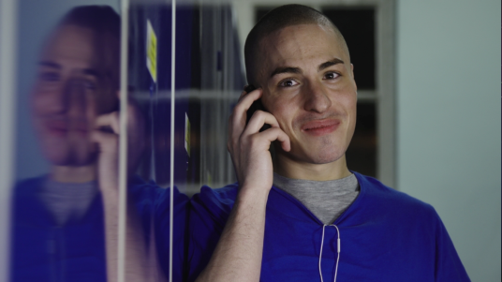
SESSION FIVE:
A Can Full of Nothing and a Shot Full of Air…

Slide 2
Drinking is cool
As 'some people say'
But do you know your facts
At the end of the day.
A lil bit o vodka
And a glass of jack deez
Enuff to put you
On your arse cos you been spiked with E'z.
A shot of Sambuca
And a healthy swig of whisky
Beths having fun and
Dirty Harry's getting frisky.

Slide 3
A party of messheads
N a bath full of sick
Dirty Harry's done a runner
An Toms getting nicked.
Now Nick, he’s a good un
As healthy as can be
Steve's off his face
‘n Nick's like a daisy.
Just like Elisha
She got a wise head
She only drink a little
Just to get outta bed.

Slide 4
See that what we need
More people to be aware
To learn of the consequences
Of those who don’t care.
Maybe not at first
But now can you see
The scary facts of alcohol
The True Reality.
So maybe a Can of Nothing
And a shot full of air…
Just drink responsibly
And make sure you're aware.

Slide 5
Chorus
Alcohol abuse can’t be used as an excuse,
Your responsible for your actions someone will stumble on the truth,
You can deny and refuse to believe what you’ve become,
Because in your reflection you’ll be exposed so it’s pointless trying to run,

